Slide 1
Glass Type Classification with Machine Learning
Igor Gatchn

Slide 2
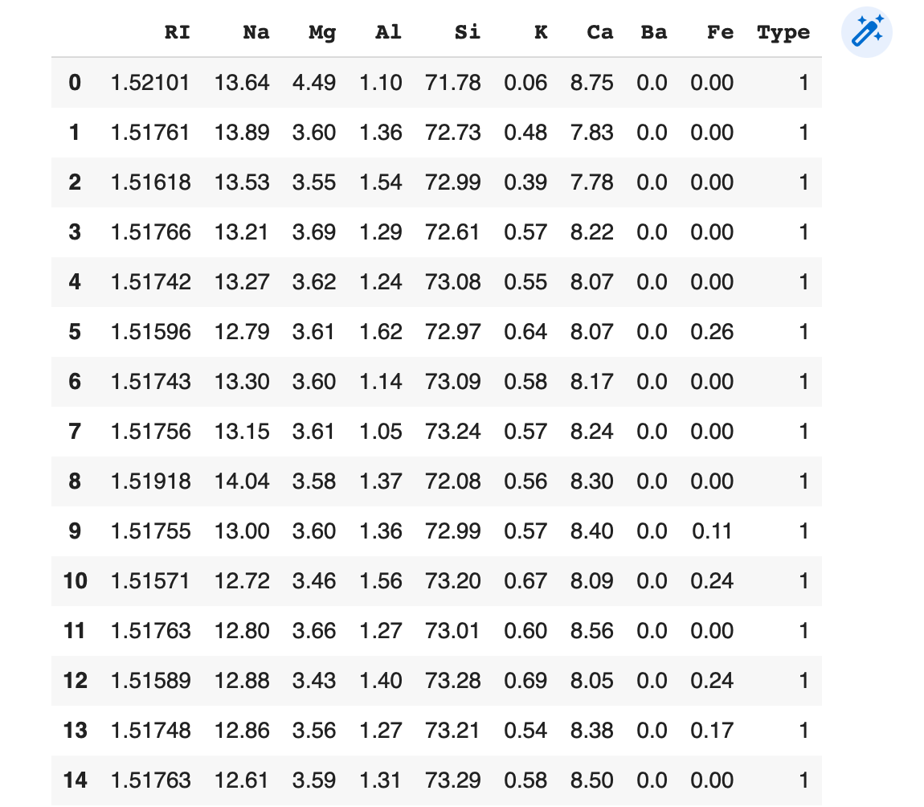
About data set
Glass Identification Data Set from UCI. It contains 10 attributes including id. The response is glass type(discrete 7 values)
The dataset reveals two important characteristics:
The variables are highly corelated with each other including the response variables
Highly Skewed Data
Notes:
Content
Attribute Information:
Id number: 1 to 214 (removed from CSV file)
RI: refractive index (показатель преломления)
Na: Sodium (натрий) (unit measurement: weight percent in corresponding oxide, as are attributes 4-10)
Mg: Magnesium
Al: Aluminum
Si: Silicon
K: Potassium (калий)
Ca: Calcium
Ba: Barium
Fe: Iron
Type of glass: (class attribute) -- 1 building_windows_float_processed (листовое окно) -- 2 building_windows_non_float_processed (не листовое) -- 3 vehicle_windows_float_processed -- 4 vehicle_windows_non_float_processed (none in this database) -- 5 containers -- 6 tableware (посуда) -- 7 headlamps (фары)
DF has 214 rows and 10 columns. The dataset consists of 214 observations.
Inspiration
Data exploration of this dataset reveals two important characteristics :
1) The variables are highly corelated with each other including the response variables:
So which kind of ML algorithm is most suitable for this dataset Random Forest , KNN or other? Also since dataset is too small is there any chance of applying PCA or it should be completely avoided?
2) Highly Skewed Data:
Is scaling sufficient or are there any other techniques which should be applied to normalize data? Like BOX-COX Power transformation?

Slide 3
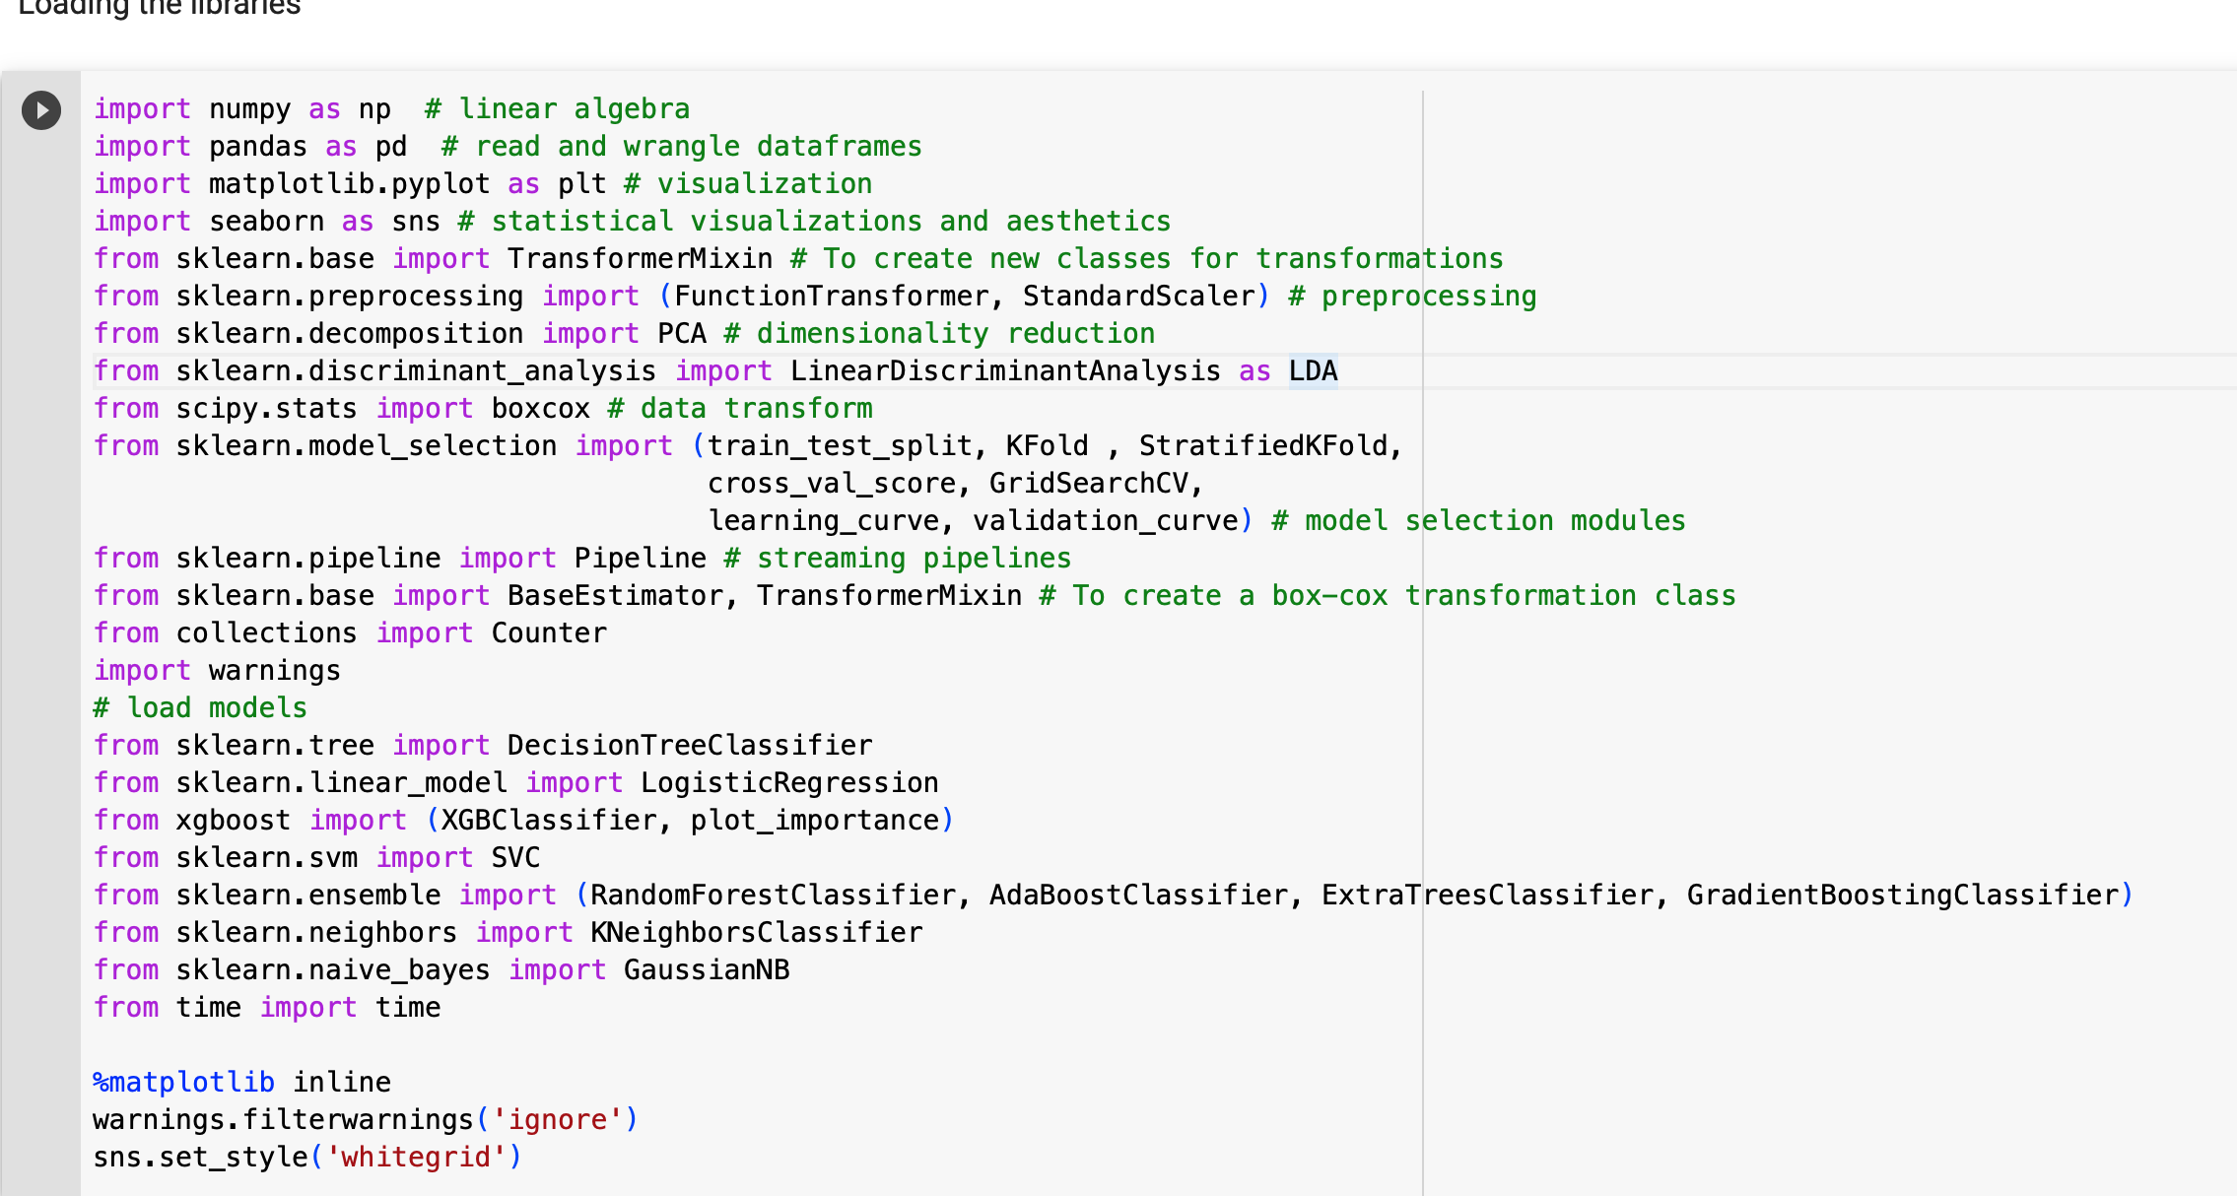
Import library
Load the following libraries
Notes:
Library that I used
Here's a brief explanation of each library and its main functions:
numpy: is a library for numerical computing in Python, which provides efficient and convenient array manipulation and mathematical operations.
pandas: is a library for data manipulation and analysis, which provides data structures for efficiently storing and manipulating large datasets.
matplotlib.pyplot: is a library for data visualization, which provides a wide variety of visualization options to create graphs, charts, and other visual representations of data.
seaborn: is a library for statistical data visualization, which provides additional visualization options and aesthetics beyond what is available in matplotlib.
sklearn.base.TransformerMixin: is a base class for creating custom transformers that can be used in a machine learning pipeline.
sklearn.preprocessing.FunctionTransformer: is a transformer that applies a user-defined function to each element or feature of a dataset.
sklearn.preprocessing.StandardScaler: is a transformer that scales features to have zero mean and unit variance.
sklearn.decomposition.PCA: is a method for reducing the dimensionality of a dataset by projecting it onto a lower-dimensional space while preserving the most important features.
sklearn.discriminant_analysis.LinearDiscriminantAnalysis: is a method for dimensionality reduction and classification that maximizes the separation between different classes.
scipy.stats.boxcox: is a method for transforming non-normal data to a more normal distribution.
sklearn.model_selection: is a library for model selection, which provides functions for splitting data into training and testing sets, cross-validation, hyperparameter tuning, and more.

Slide 4
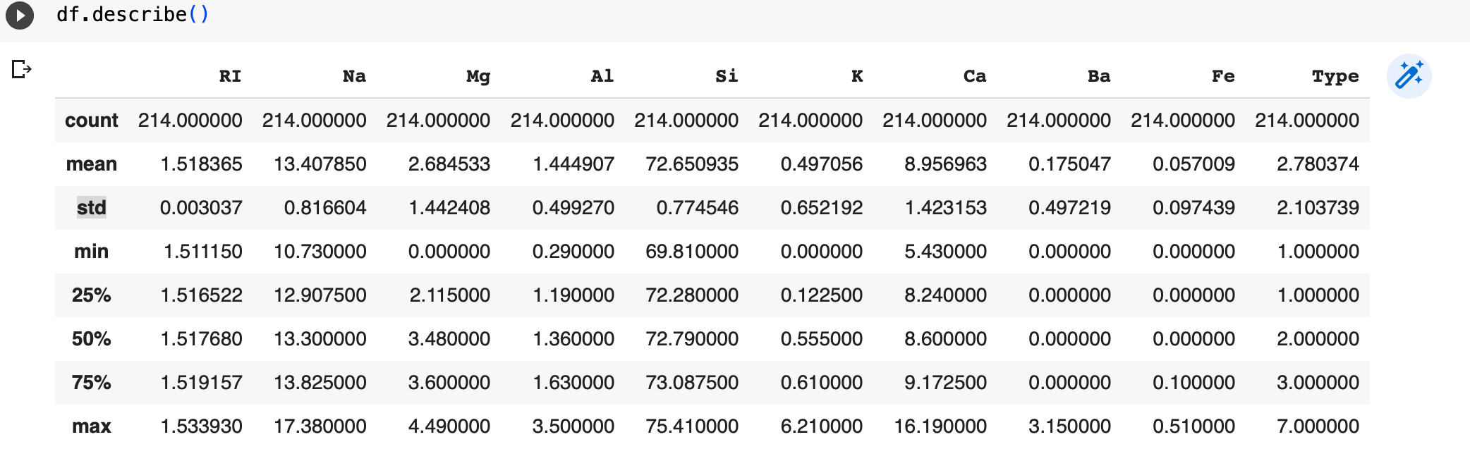
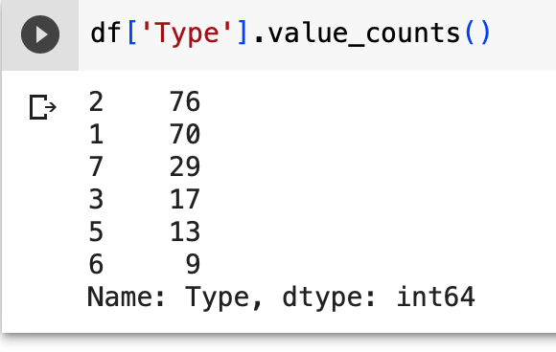
Summarize data
Notes:
The features are not on the same scale. For example Si has a mean of 72.65 while Fe has a mean value of 0.057. Features should be on the same scale for algorithms such as logistic regression (gradient descent) to converge smoothly. Let's go ahead and check the distribution of the glass types.
he dataset is pretty unbalanced. The instances of types 1 and 2 constitute more than 67 % of the glass types.

Slide 5
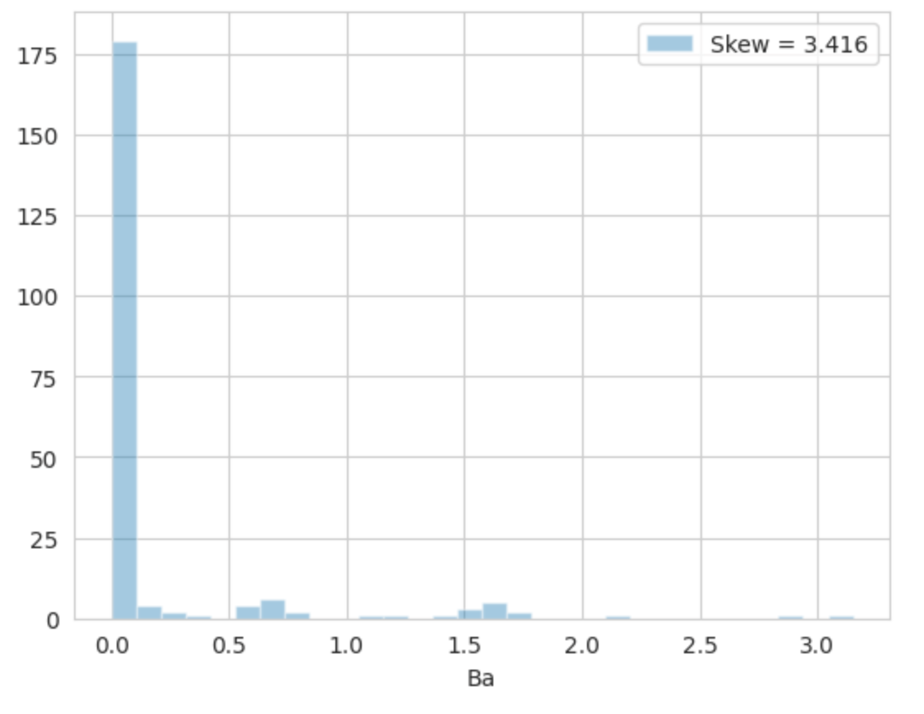
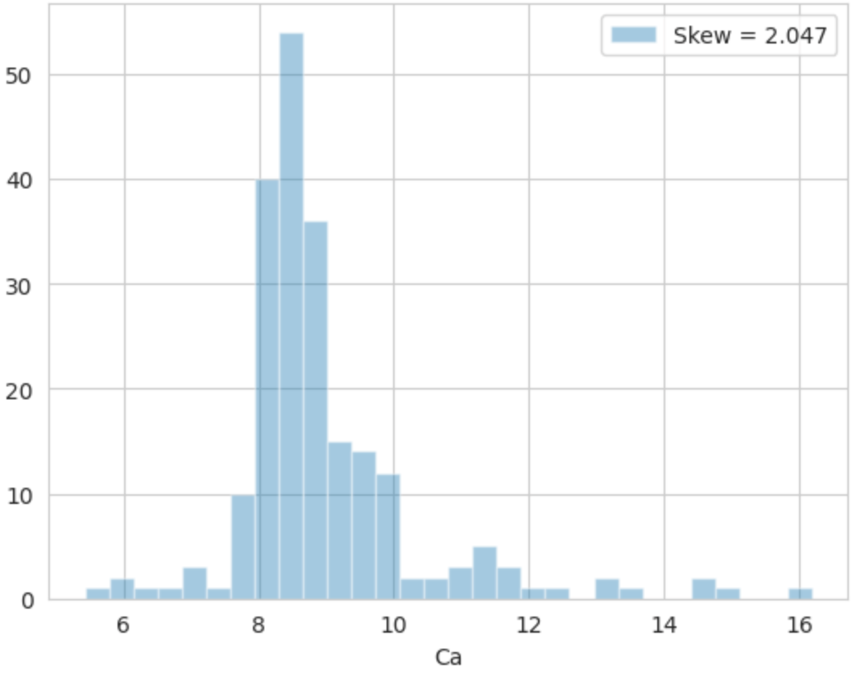
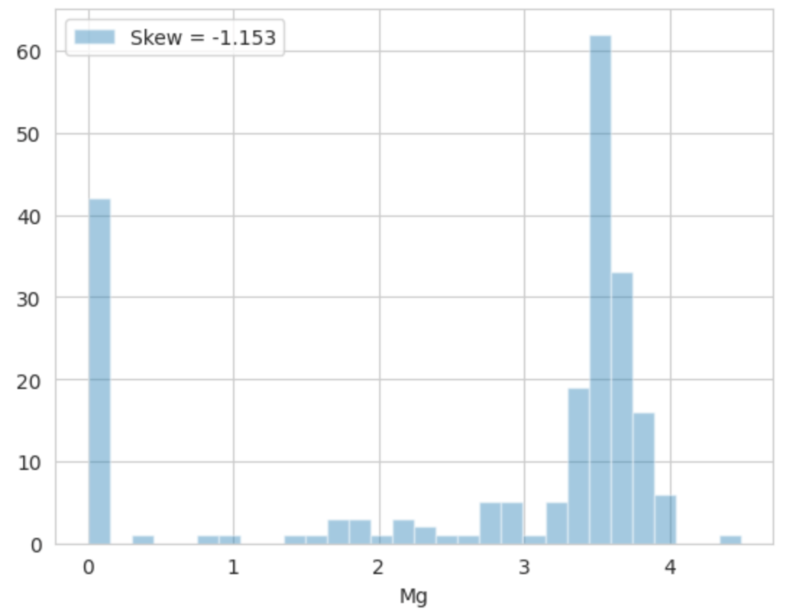
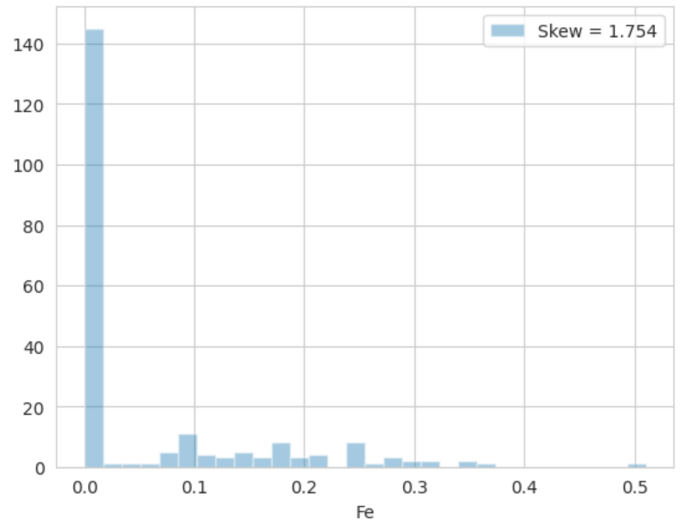
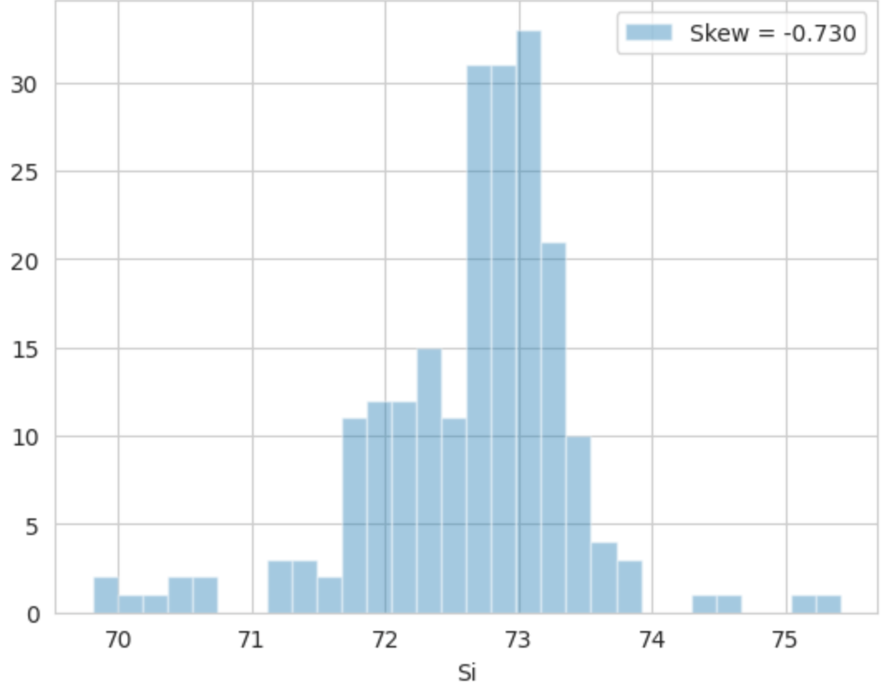
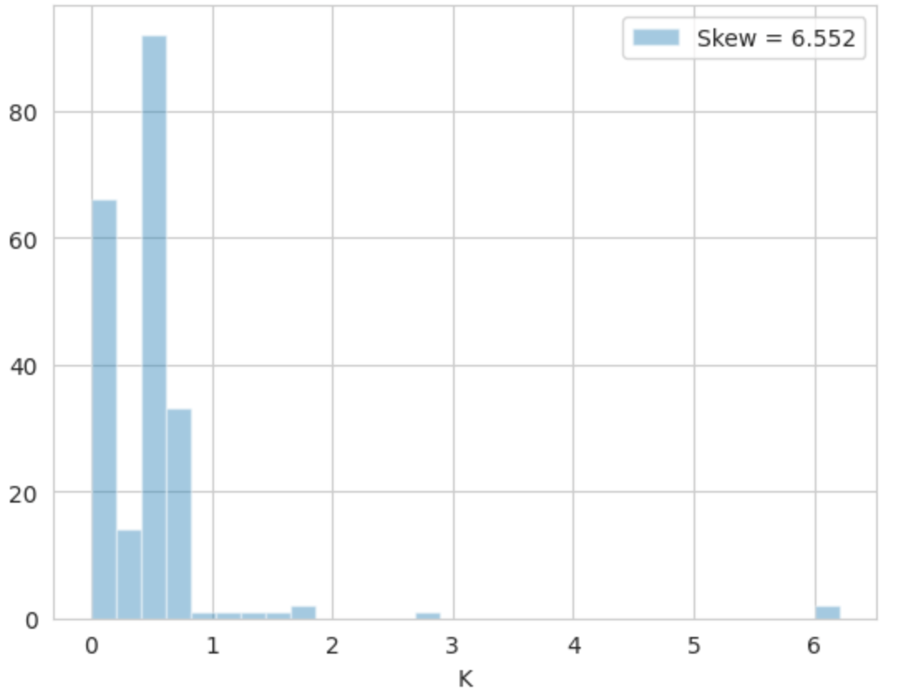
Data Visualization
Notes:
Let's go ahead an look at the distribution of the different features of this dataset
None of the features is normally distributed. The features Fe, Ba, Ca and K exhibit the highest skew coefficients. Moreover, the distribution of potassium (K) and Barium (Ba) seem to contain many outliers. Let's identify the indices of the observations containing outliers using Turkey's method.

Slide 6
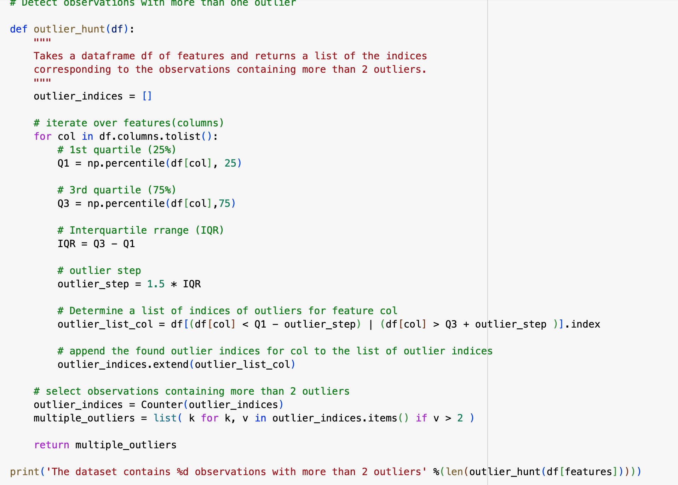
Tukey's method
Output: The dataset contains 14 observations with more than 2 outliers
Notes:
Turkey's method, also known as the Tukey's fences method or the Tukey's test, is a statistical technique used for identifying outliers in a dataset. It defines a range of values called fences that are used to identify observations that are significantly different from the majority of the data.
In Tukey's method, outliers are identified using the interquartile range (IQR), which is the range between the first quartile (Q1) and the third quartile (Q3) of the data. The method defines an upper fence and a lower fence as follows:
Upper Fence: Q3 + (1.5 * IQR)
Lower Fence: Q1 - (1.5 * IQR)
Any observation that falls outside these fences is considered an outlier. The factor of 1.5 is a common choice, but it can be adjusted based on the specific requirements of the analysis.
There exists some 14 observations with multiple outliers. These could harm the efficiency of our learning algorithms. We'll make sure to get rid of these in the next sections.

Slide 7
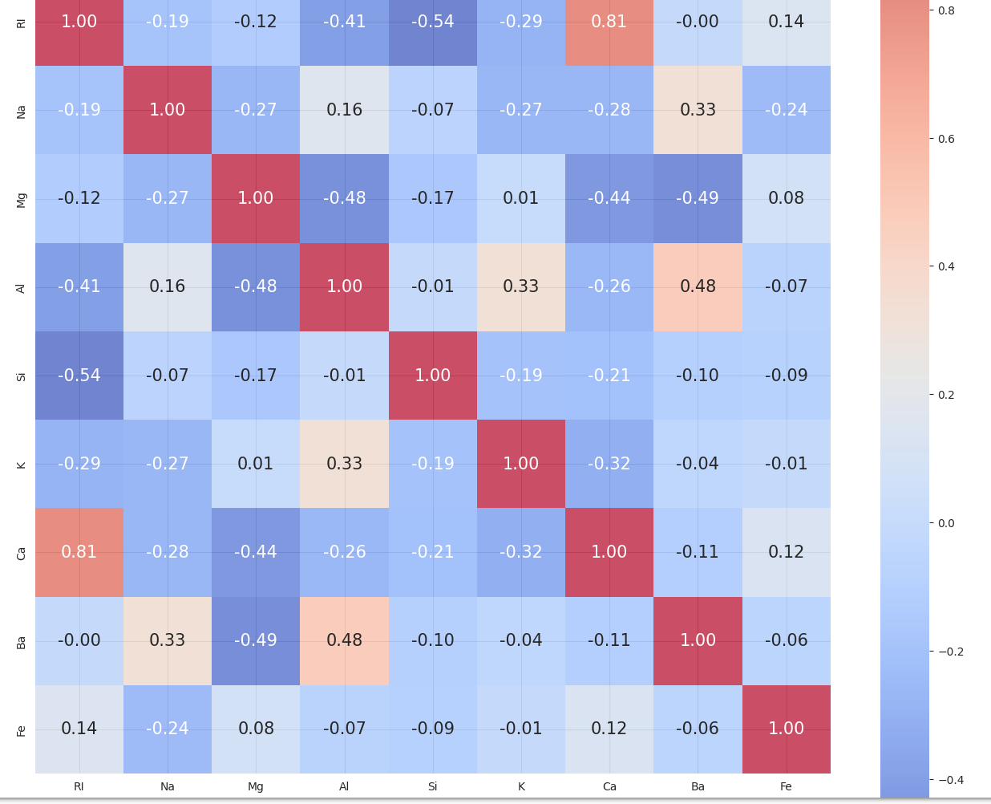
A heatmap of the correlations
Notes:
There seems to be a strong positive correlation between RI and Ca. This could be a hint to perform Principal component analysis in order to decorrelate some of the input features.
RI: refractive index
Na: Sodium (натрий) (unit measurement: weight percent in corresponding oxide, as are attributes 4-10)
Mg: Magnesium
Al: Aluminum
Si: Silicon
K: Potassium (калий)
Ca: Calcium
Ba: Barium
Fe: Iron
A correlation coefficient measures the strength and direction of the linear relationship between two variables. The value of the correlation coefficient ranges from -1 to 1, where:
* -1 represents a perfect negative correlation (as one variable increases, the other decreases linearly),
* 0 represents no correlation (no linear relationship between the variables),
* 1 represents a perfect positive correlation (as one variable increases, the other increases linearly).

Slide 8
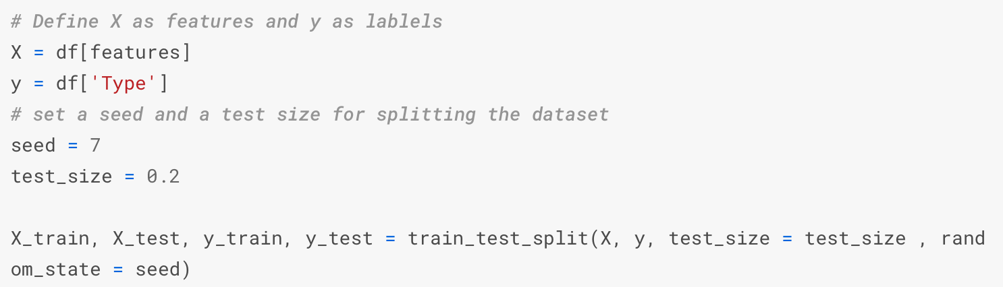
Prepare data
Remove the observations containing multiple outliers ( more than 2) with the function we created in the previous section.
Plot distribution of types
Split-out validation dataset

Slide 9
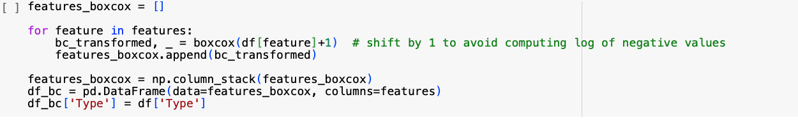
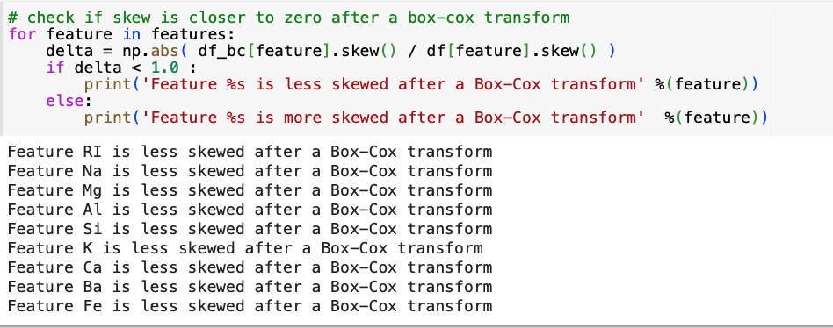
Data transformation
Notes:
Let's examine if a Box-Cox transform can contribute to the normalization of some features. It should be emphasized that all transformations should only be done on the training set to avoid data snooping. Otherwise the test error estimation will be biased.
The Box-Cox transformation is a technique used to stabilize the variance of a variable and make it approximately follow a normal distribution. It is particularly useful when dealing with skewed data or when the assumption of normality is required for statistical analysis or modeling.
In the code you provided, the Box-Cox transformation is applied to each feature in the DataFrame df using the boxcox function. Here's an explanation of the steps:
It initializes an empty list called features_boxcox to store the transformed features.
The code iterates over each feature in the features list.
For each feature, it applies the Box-Cox transformation using the boxcox function. df[feature]+1 is passed as the input to the boxcox function, where 1 is added to avoid taking the logarithm of negative values (since the Box-Cox transformation involves computing logarithms).
The boxcox function returns the transformed values (bc_transformed) and the lambda parameter used for the transformation (which is not used in this code snippet, indicated by the underscore _).
The transformed feature (bc_transformed) is appended to the features_boxcox list.
After iterating over all features, the features_boxcox list is converted into a numpy array using np.column_stack(features_boxcox). This creates a 2D array where each transformed feature is a column.
The transformed array is then used to create a new DataFrame df_bc using pd.DataFrame(data=features_boxcox, columns=features) with the original feature names as column names.
The 'Type' column from the original DataFrame df is appended to the new DataFrame df_bc using df_bc['Type'] = df['Type']. This step ensures that the target variable or any additional relevant columns are retained in the transformed DataFrame.
The resulting df_bc DataFrame contains the Box-Cox transformed features, which are expected to have a more symmetric distribution and potentially exhibit a more constant variance, making them suitable for certain statistical analyses or modeling techniques that assume normality or require standardized variables.
The Box-Cox transform seems to do a good job in reducing the skews of the different distributions of features. However, it does not lead to the normalization of the feature distributions. Trial and error showed that it doesn't lead to an improvement of the performance of the used algorithms. Next, let's explore dimensionality reduction techniques. Like - Dimensionality reduction.
After that I will plan to compare the performance of different machine learning algorithms.
After that Tuning Random Forests.
And in the end Diagnose the performance of the best algorithms

Slide 10
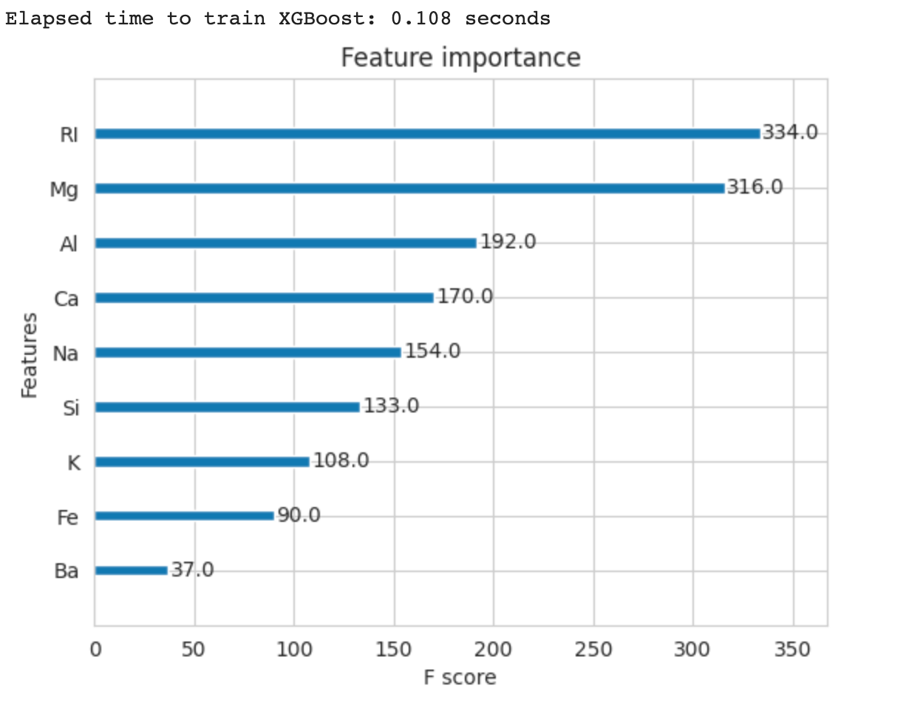
Evaluate Algorithm
XGBoost
Notes:
XGBoost (Extreme Gradient Boosting) is a popular machine learning algorithm that belongs to the family of gradient boosting methods. It is widely used for both regression and classification tasks and has gained significant popularity in various data science competitions and real-world applications.
XGBoost is an ensemble method that combines the predictions of multiple weak learners (decision trees) to create a strong predictive model. It leverages the concept of boosting, where subsequent models are trained to correct the mistakes made by the previous models. This iterative process continues until the model reaches a desired level of accuracy or a predefined number of models (trees) is reached.
In summary, this code snippet demonstrates the process of training an XGBoost classifier, measuring the elapsed time for training, and visualizing the feature importances of the trained model. It is assumed that the necessary data (X_train and y_train) has been prepared before this code snippet.
It appears that no main features dominate the importance in the XGBoost modeling of the problem.

Slide 11
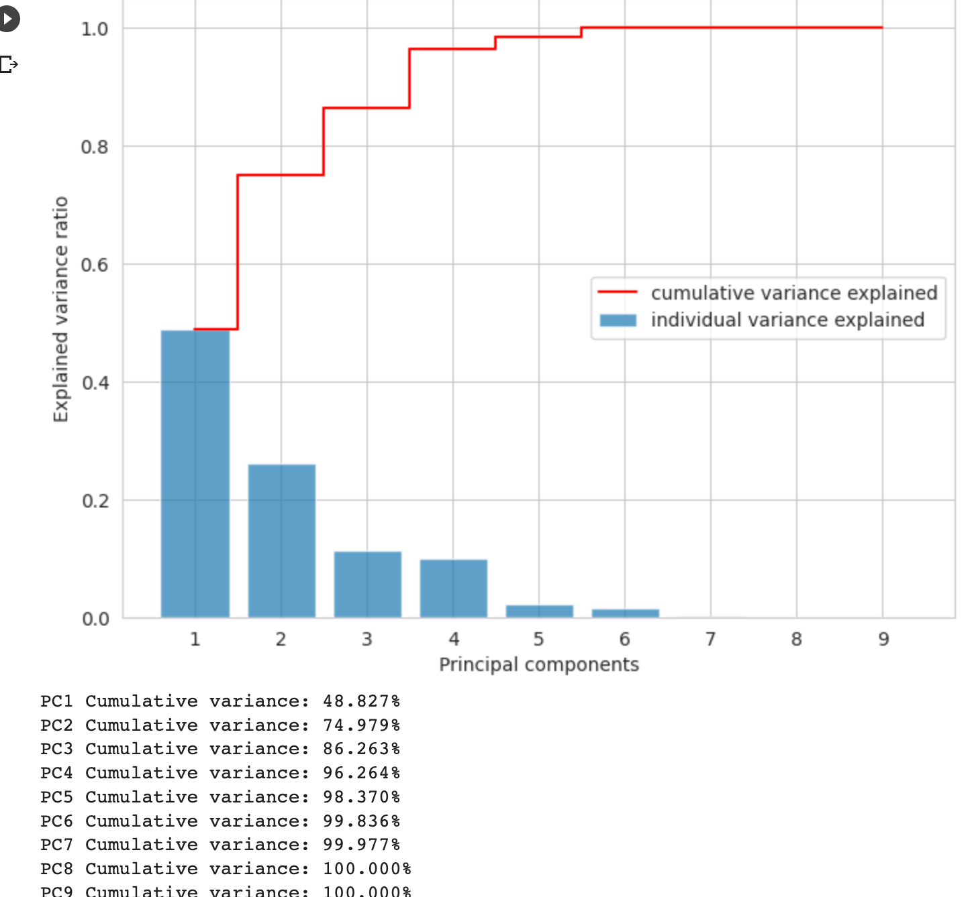
Evaluate Algorithm
PCA
Notes:
PCA (Principal Component Analysis) is a dimensionality reduction technique that is often used in the evaluation of algorithms. It helps to understand the underlying structure of data by transforming the original features into a new set of uncorrelated variables called principal components.
Let's go ahead and perform a PCA on the features to decorrelate the ones that are linearly dependent and then let's plot the cumulative explained variance.
It appears that about 99 % of the variance can be explained with the first 5 principal components. However feeding the PCA features to the learning algorithms did not contribute to a better performance. This might be due to the non-linearites that PCA is not able to capture.

Slide 12
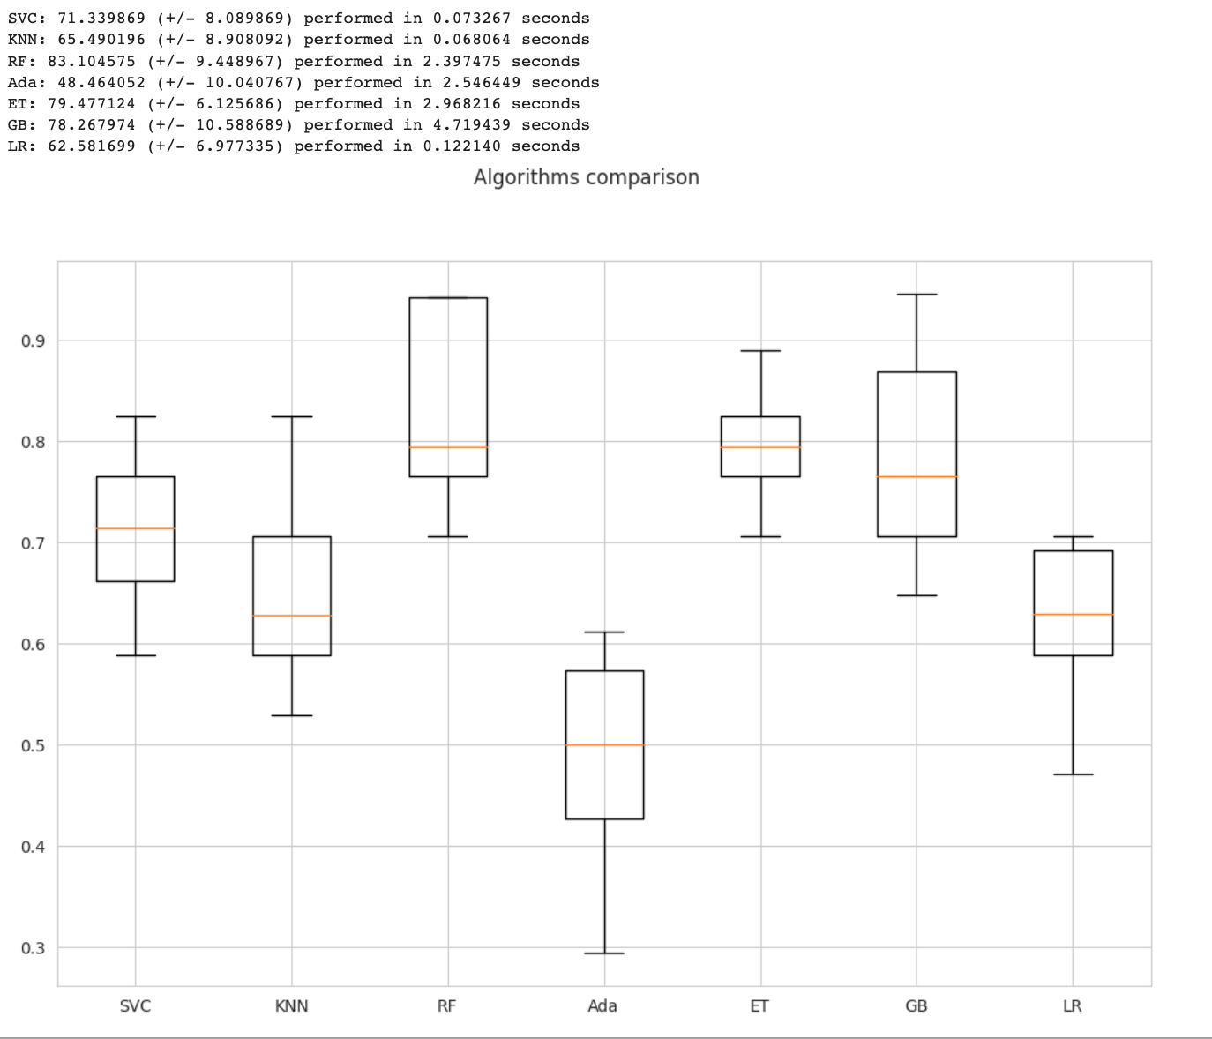
Compare Algorithm
Observation:
The best performances are achieved by RF. However, RF also yields a wide distribution. It is worthy to continue our study by tuning RF.
Logistic Regression performs badly. This might be due to the fact that the data is not normally distributed as these algorithms perform well when data that is normally distributed.
Notes:
Now it's time to compare the performance of different machine learning algorithms. We'll use 10-folds cross-validation to assess the performance of each model with the metric being the classification accuracy. Pipelines encompassing Standarization and PCA are used in order to avoid data leakage. Standarization is not performed for tree-based methods.

